Slide 1

EvnChain
Battling Pollution || Bringing Profits

Slide 2
About us
Team Syndicate From Army Institute of Technology, PUNE
Anirudh Murali
https://www.linkedin.com/in/anirudh-murali/
Salil Gautham
https://www.linkedin.com/in/salil-gautam/

Slide 3
Problem Definition
The quality of air is constantly degrading in India. Pollution is at a peak with no clear solution to tackle it.
India's high air pollution, is among the worst in the world
660 million people live in areas where PM levels is above safe standards
Of the world’s top 20 polluted cities, 13 are in India

Slide 4
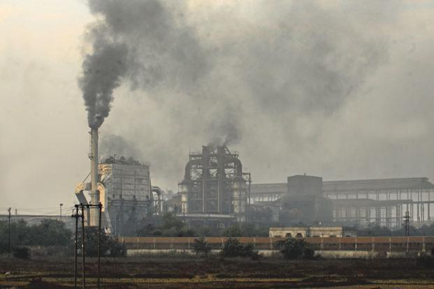
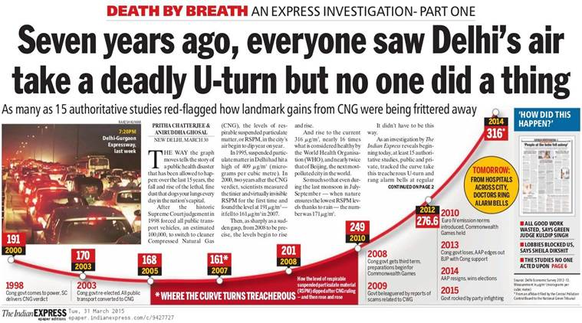
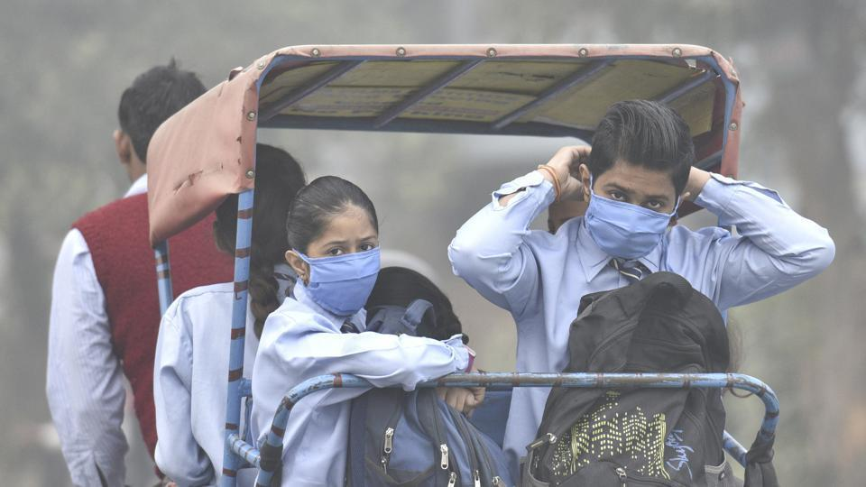
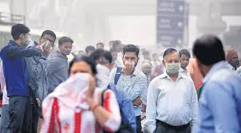
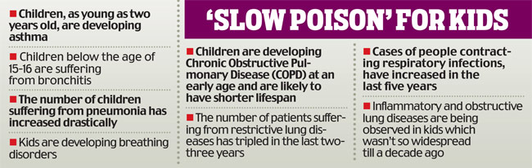
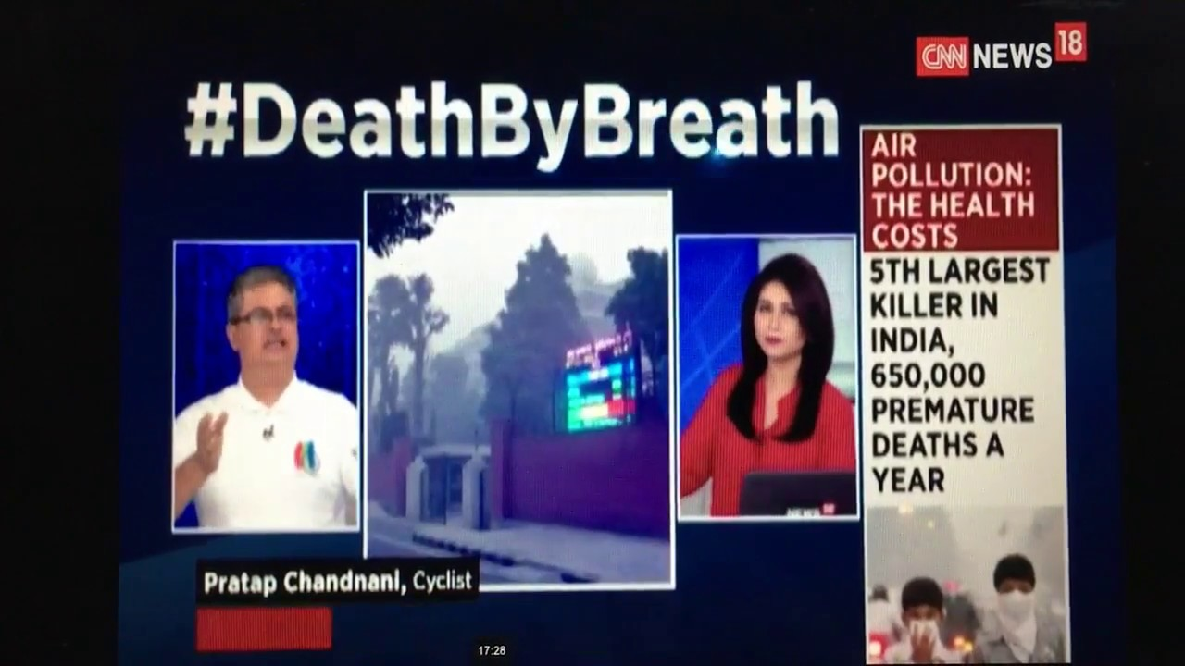
Problem Statement

Slide 5
Current Scenario
The current centralized monitoring system faces critical problems mainly
Scalability
Cost
Trust

Slide 6


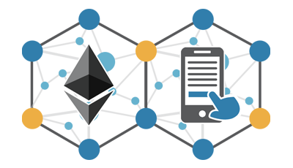
Our Solution
To control pollution in a collaborative manner by deploying a decentralized network of air pollution monitoring sensors
Decentralized network endpoints are sensors owned by individuals,
completely distributed, decentralized interactions
Data generated is owned by the user.
Specifically Designed Smart contracts to provide incentives to all partes

Slide 7



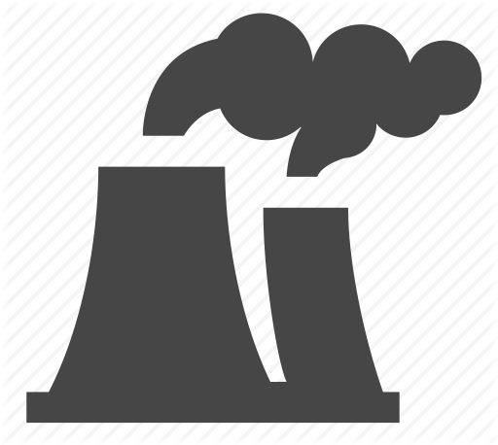
Participating Parties
Common Citizens
Data buying companies
Government
Manufacturing
Plants

Slide 8
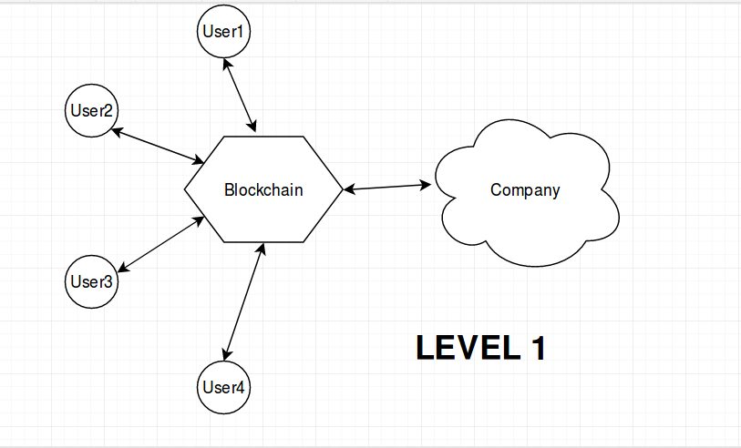

Slide 9
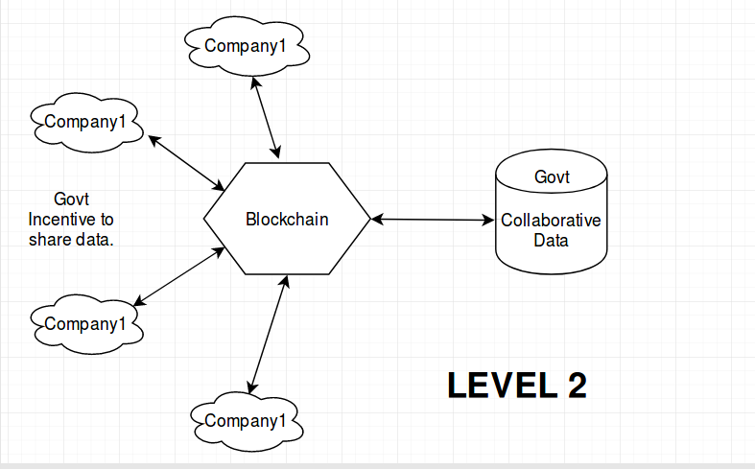

Slide 10
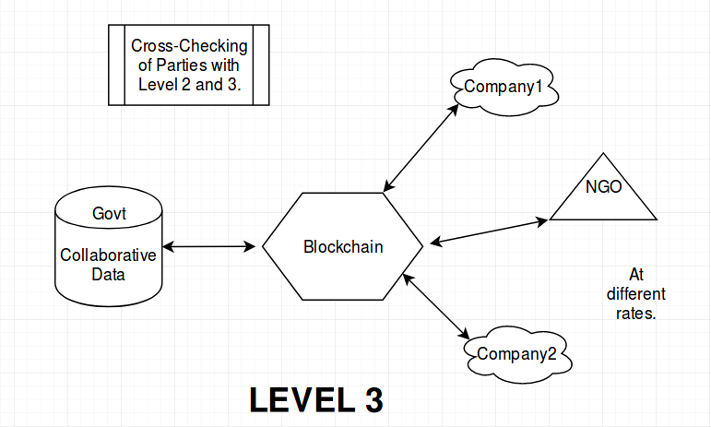

Slide 11
DEMO
Github: https://github.com/Anirudh-Murali/Evn
Demo video: https://www.youtube.com/watch?v=1wFEWouW2r8

Slide 12
Our Solution
Transparent
Incentivize
Immutable
The nature of blockchain technology means that all data stored on it is public, and unchangeable, so even if a company tried to buy up all of the data damning them for pollution, they would not be able to hide it from the public or change the the data.

Slide 13
Thank You

